Slide 1
Single-cell analysis for Mono cells
Feng Tian
6/26/2018
Notes:
大家好，今天我总结一下目前的一些进展。

Slide 2
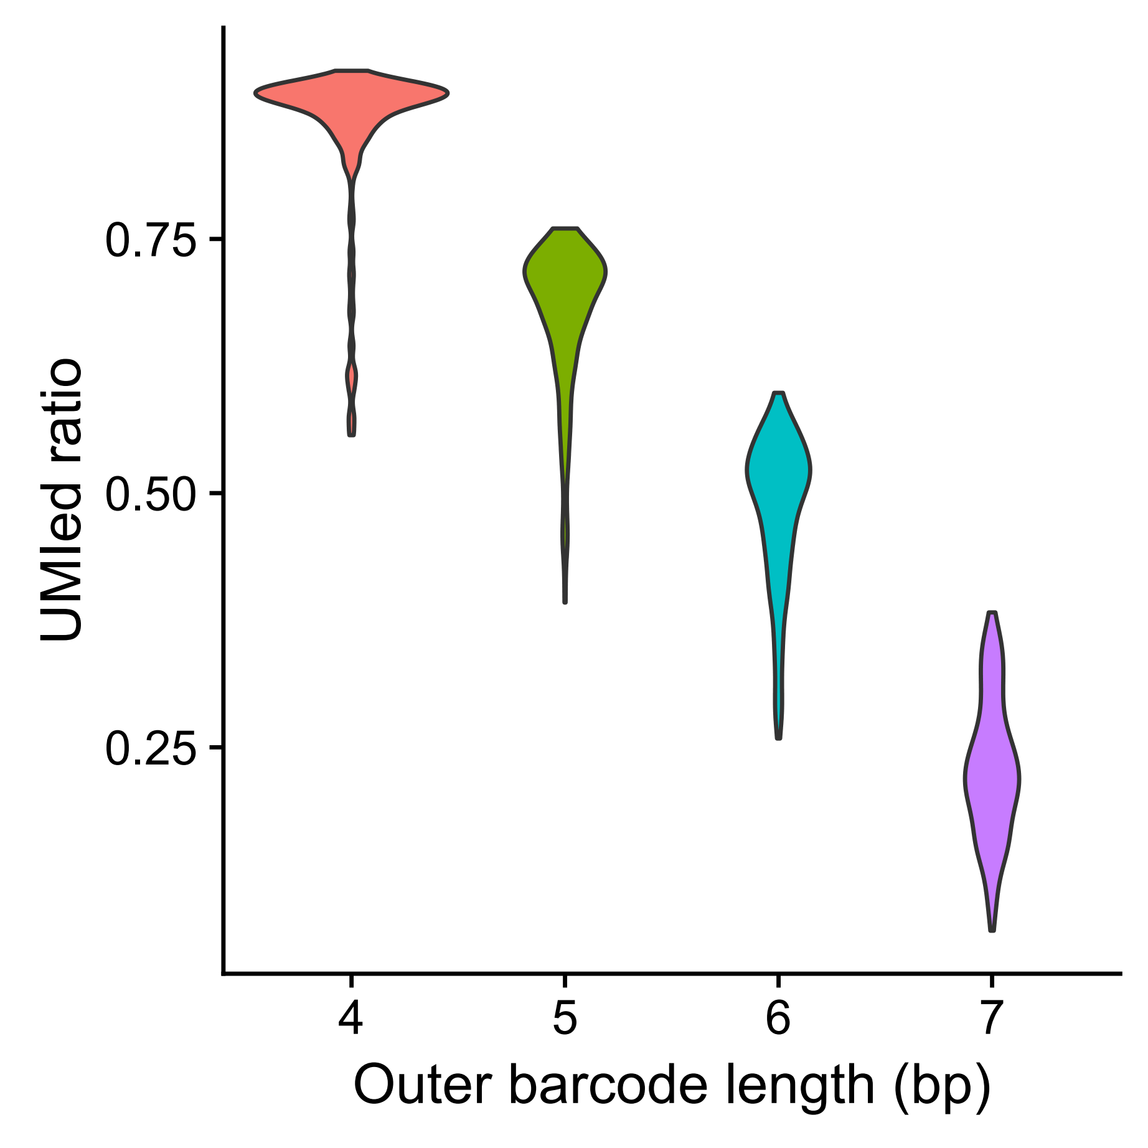
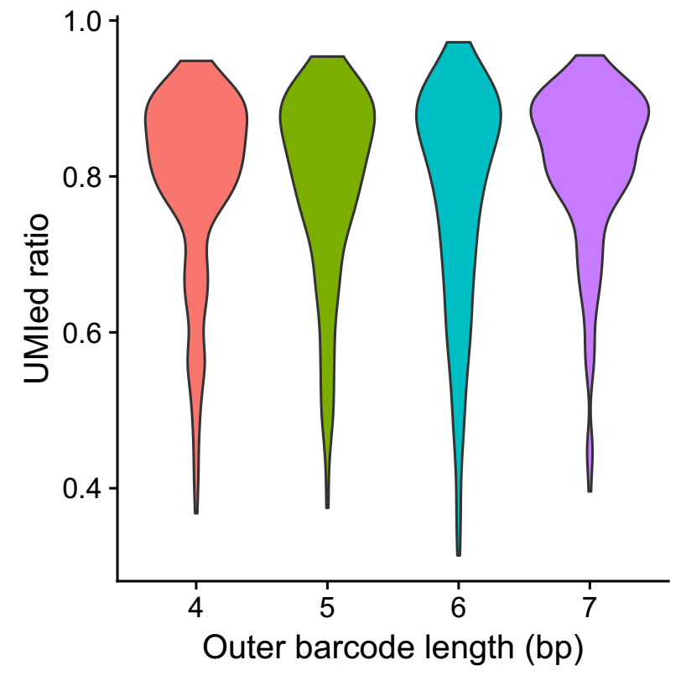
Read2 polyT issue
The polyT pattern has been improved by Phix
Ratio of Read2 with polyT
(>=4 T in 5bp)
Without Phix
With Phix

Slide 3
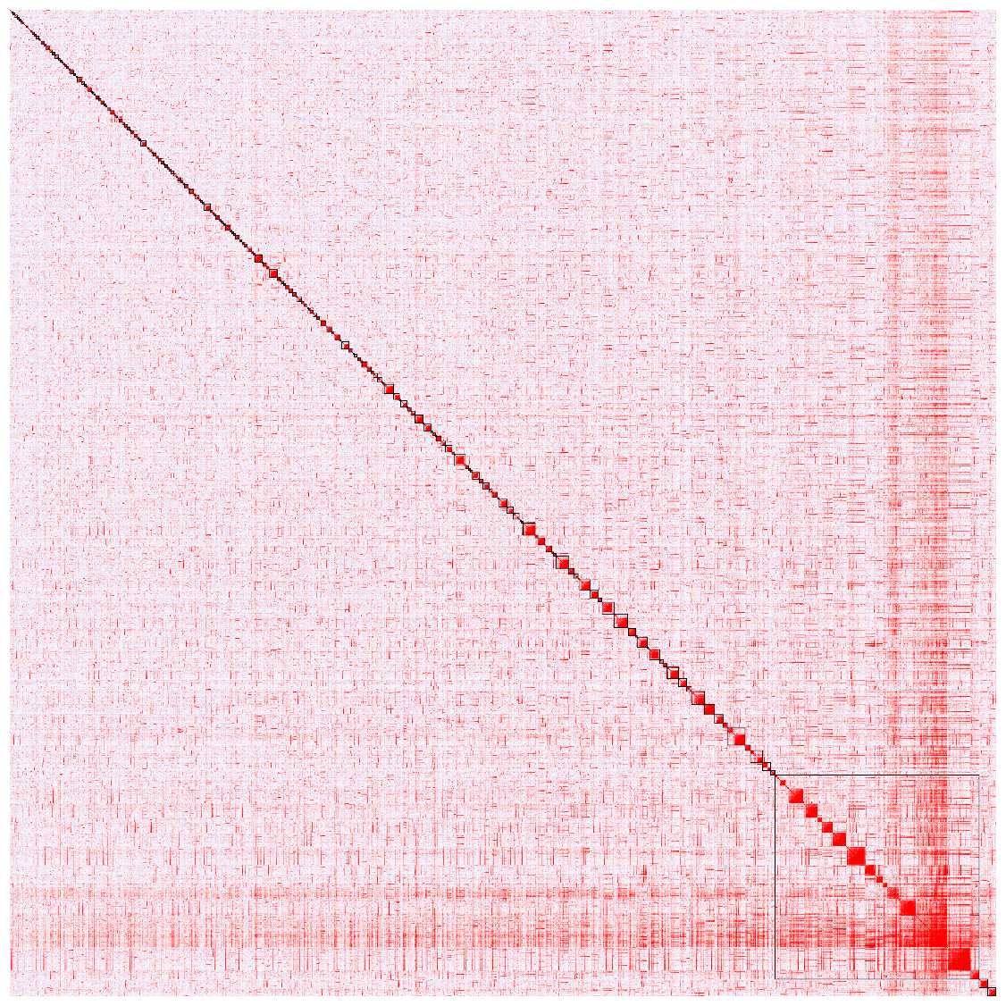
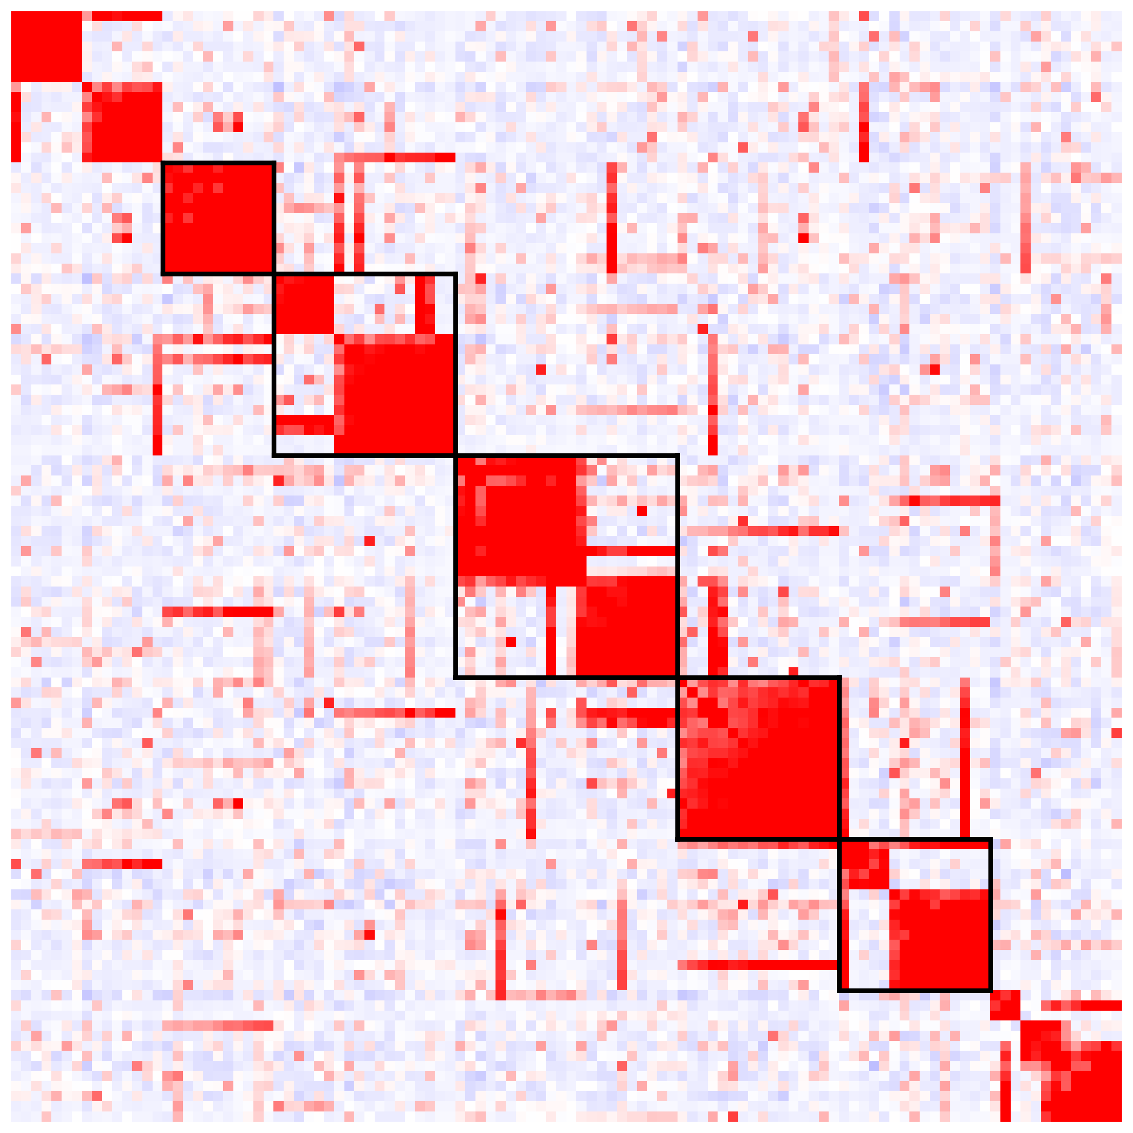
Co-expression modules (8830 genes * 580 cells)
210 modules
Highlight: the first 5 modules

Slide 4
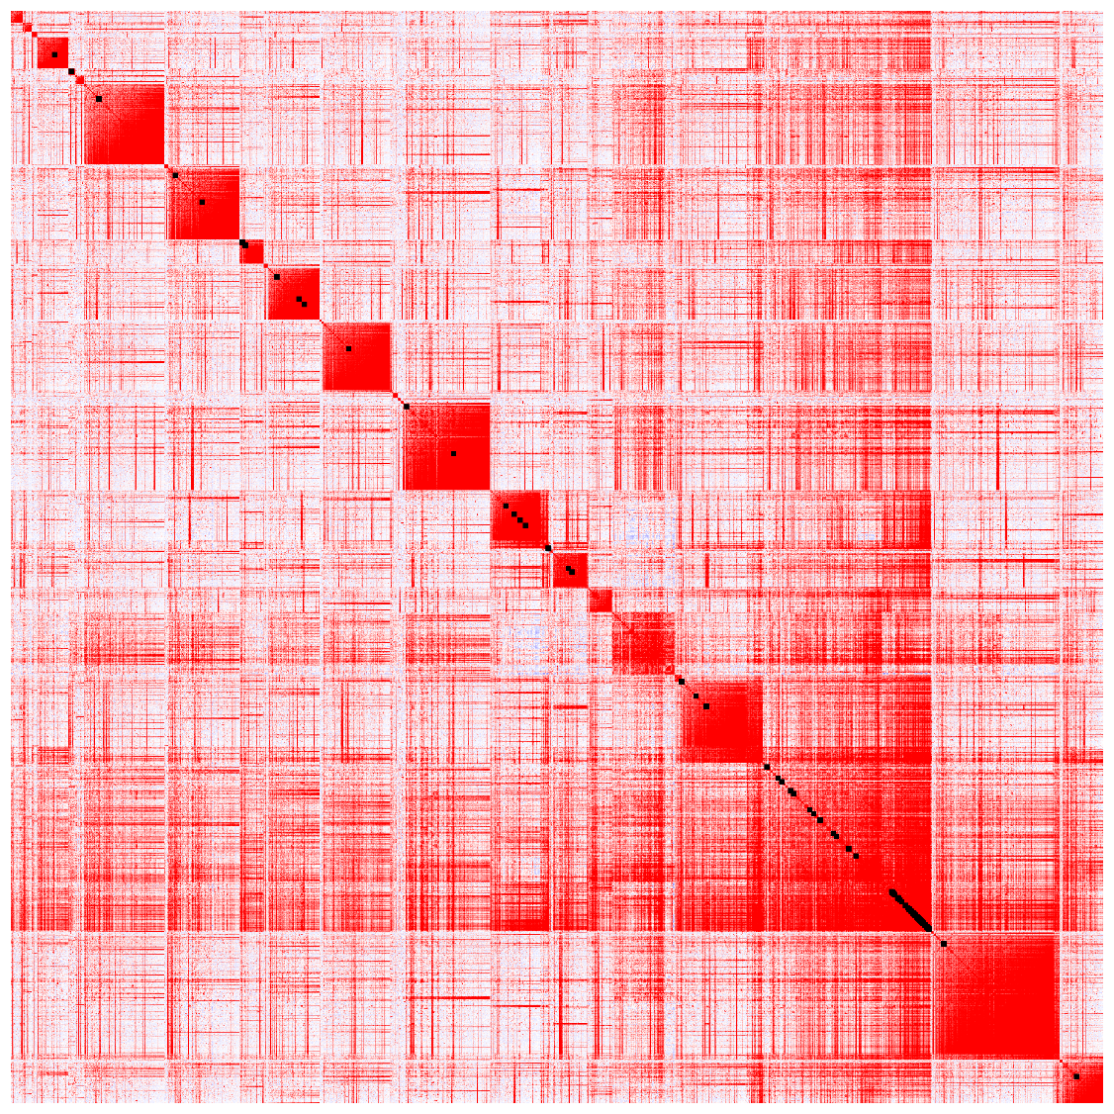
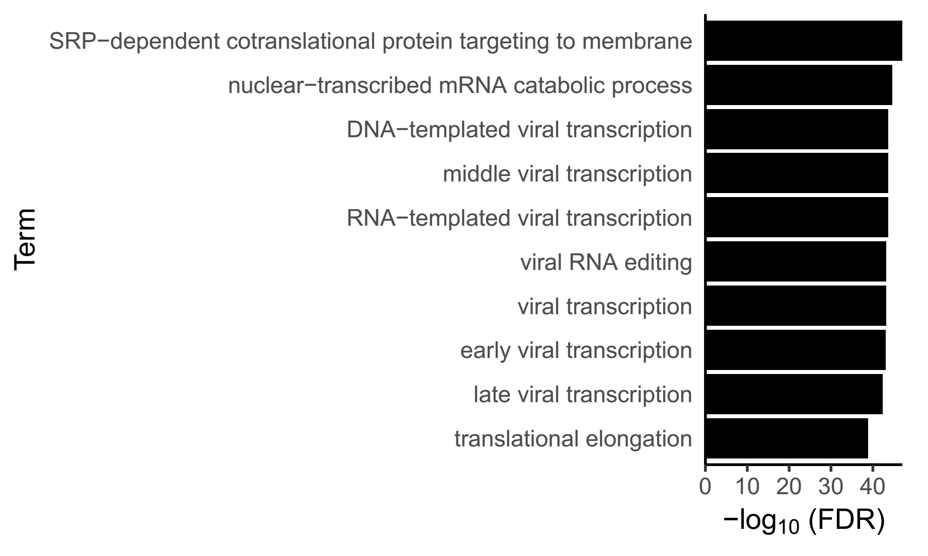
Co-expression modules (8830 genes * 580 cells)
A module (id: 207) contains 1827 genes
Highlight: viral RNA editing

Slide 5
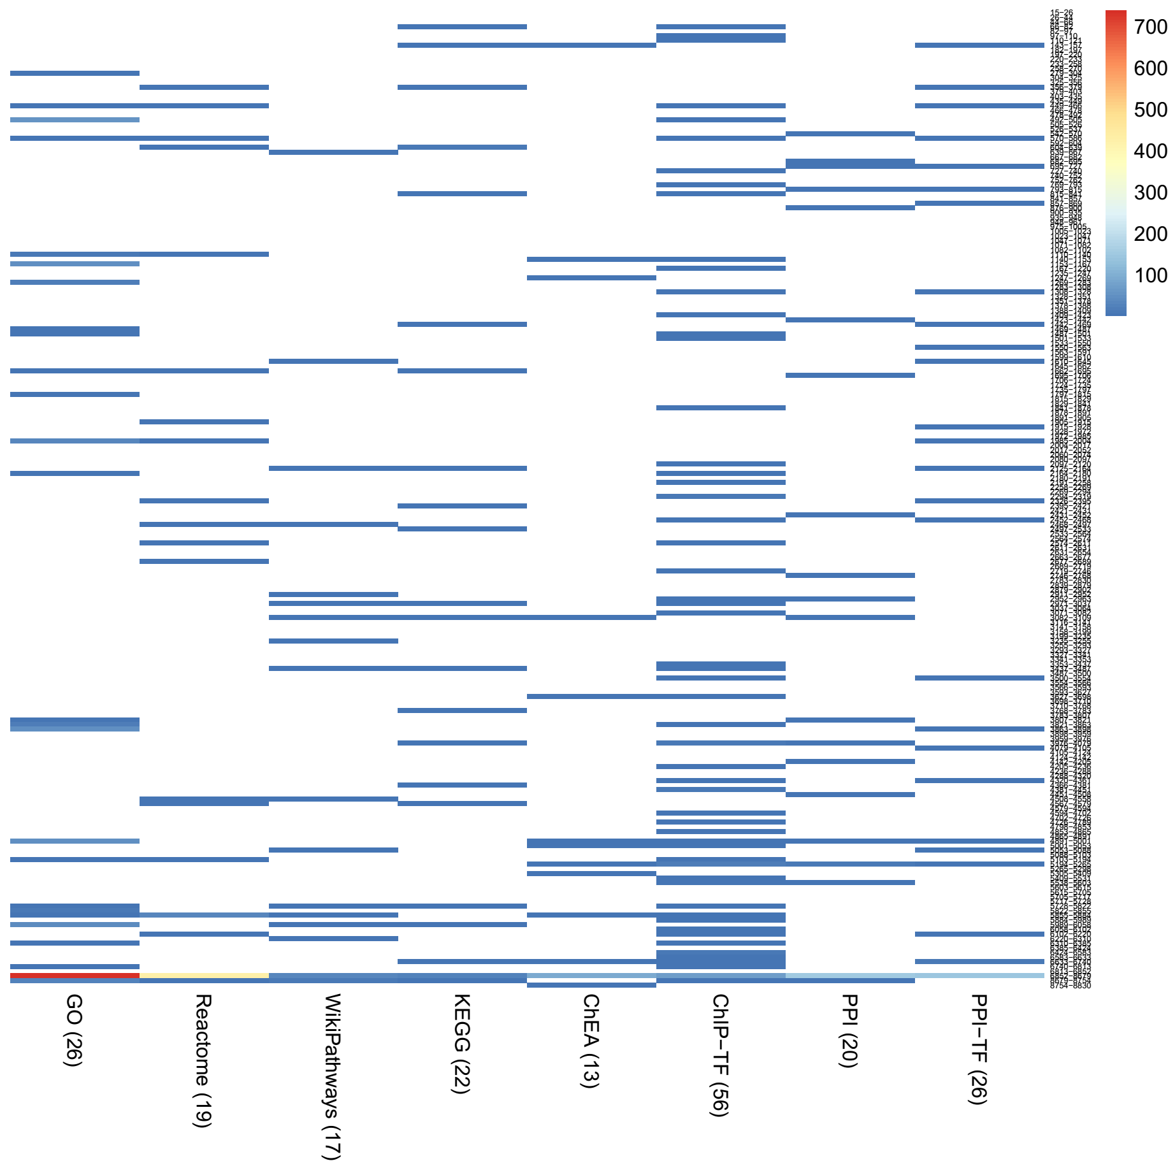
Co-expression modules (8830 genes * 580 cells)
Label 108 modules based on enriched terms

Slide 6
Co-expression modules
Label 43 modules based on enriched terms (GO / KEGG)
module | Term | Overlap | Annotated
6852-8679 | SRP-dependent cotranslational protein targeting to membrane, docking | 67 | 88
1662-1695 | type I interferon signaling pathway | 6 | 148
1153-1167 | positive regulation of protein import into nucleus, translocation | 3 | 20
66-82 | Pyrimidine metabolism | 3 | 105
3807-3821 | 1-phosphatidyl-1D-myo-inositol 3,5-bisphosphate biosynthetic process | 3 | 75
1797-1815 | DNA strand elongation involved in DNA replication | 3 | 25
1269-1283 | negative regulation of anoikis | 4 | 336
5822-5855 | carbohydrate phosphorylation | 3 | 35
4366-4381 | Tuberculosis | 3 | 178
449-466 | T cell proliferation | 3 | 41
3082-3109 | p53 signaling pathway | 3 | 69
5855-5884 | positive regulation of floral organ abscission | 3 | 38
1442-1469 | RNA degradation | 3 | 77
1110-1140 | positive regulation of floral organ abscission | 3 | 38
6633-6740 | 2-Oxocarboxylic acid metabolism | 3 | 17
6310-6385 | maturation of SSU-rRNA from tetracistronic rRNA transcript | 3 | 16
356-379 | Alzheimer's disease | 3 | 168
143-157 | HTLV-I infection | 3 | 258
570-586 | negative regulation of signal transduction by p53 class mediator | 3 | 128
8679-8754 | FoxO signaling pathway | 5 | 133
604-639 | Estrogen signaling pathway | 3 | 99
6740-6813 | posttranslational protein targeting to endoplasmic reticulum membrane | 4 | 39

Slide 7
Co-expression modules
Label 43 modules based on enriched terms (continued)
5728-5822 | negative regulation of G1/S transition of mitotic cell cycle | 4 | 34
815-841 | Protein processing in endoplasmic reticulum | 3 | 169
3863-3898 | negative regulation of arginine catabolic process | 4 | 259
5989-6058 | cellular response to 3,3',5-triiodo-L-thyronine | 3 | 38
2395-2421 | MAPK signaling pathway | 3 | 255
5103-5194 | negative regulation of endothelial cell-matrix adhesion via fibronectin | 3 | 11
2497-2533 | Transcriptional misregulation in cancer | 3 | 180
3768-3783 | MAPK signaling pathway | 3 | 255
4567-4579 | Metabolic pathways | 4 | 1239
2971-3037 | Huntington's disease | 5 | 193
4891-5001 | histone-tyrosine phosphorylation | 4 | 54
3976-4079 | Cytosolic DNA-sensing pathway | 4 | 64
279-304 | protein glycosylation | 3 | 122
3821-3863 | apoptotic process | 4 | 196
492-505 | positive regulation of cellular alcohol catabolic process | 3 | 720
3437-3487 | cAMP signaling pathway | 4 | 199
2164-2180 | canonical Wnt signaling pathway involved in positive regulation of apoptotic process | 3 | 279
1985-2004 | positive regulation of cardiac muscle cell proliferation | 3 | 334
1487-1501 | actin ubiquitination | 3 | 226
2125-2164 | Apoptosis | 3 | 140
1469-1487 | common-partner SMAD protein phosphorylation | 4 | 303

Slide 8
Thanks
Notes:
http://www.nature.com/news/the-human-cell-atlas-from-vision-to-reality-1.22854

